Slide 1
Data Preparation for Data Mining
MAS DSE
April 2015

Slide 2
Outline
Motivation and Goals
What is data?
Data Preparation:
Organizing data (structural issues)
Preprocessing (data value issues)
Exploring Variables and Descriptive Statistics
Exploring the Data Matrix
Outliers, Anomalies, and Visualizations
Notes:
Data prep is now its own topic, even books focused on it, defined by its practice , b/c data is so open ended
The process is iterative, so that one might

Slide 3
The Importance of Data Prep
“Garbage in, garbage out”
A crucial step of the DM process
Could take 60-80% of the whole data mining effort

Slide 4
Working definition
Data Preparation:
Cleaning, filtering, transforming, and organizing the data
Preparing data for modeling
Data Munging
Feature Engineering

Slide 5
Prerequisites
Data Understanding:
Descriptors, values, ranges, labels
Data History
Domain Knowledge
Meaning and data relations
Questions to be addressed

Slide 6
Input - Output
Inputs:
raw data
Outputs:
two data sets: training and test (if available)
Training further broken into training and validation
Notes:
We will talk about the PIEs in more details

Slide 7
End Product: Quality Data
Accurate
Complete
Consistent
Interpretable
In other words: Good data →Better results!
Notes:
So, what does good quality data look like?

Slide 8
Outline
Motivation and Goals
What is data?
Data Preparation:
Organizing data (structural issues)
Preprocessing (data value issues)
Exploring Variables and Descriptive Statistics
Exploring Data Matrix
Outliers, Anomalies, and Visualizations
Notes:
Data prep is now its own topic, even books focused on it, defined by its practice , b/c data is so open ended
The process is iterative, so that one might

Slide 9

Recall the KDD Process
Database
Data Preparation
Data Mining
Model, Patterns
Training Data
Evaluation, Verification
Notes:
Knowledge discovery in Databases (KDD) is a non-trivial process of identifying, valid, novel, potentially useful and ultimately understandable patterns in data stored in large databases, data warehouses, and other massive information repositories
Data preparation:
Cleaning- remove noise and inconsistent data
Filtering, Integration – multiple data sources may be combined

Slide 10
From Data Source To Algorithm Input
Training Data
Database
Data Preparation
Database
Database
Test Data
User Decides:
Selection Criteria –
Joins => denormalize
How much data?
Depends on needs and
domain knowledge about
what’s relevant
User Performs:
Cleaning data and Transformations
Depends on domain knowledge,
data itself and possibly on
algorithms
Notes:
The part of the overall KDD process is from data to trainning data
(and in fact, it will be training data , test data, and the training data may have validation data)

Slide 11
Data Terminology
Data consists of:
Examples, observations, measurements, events, transactions, records..
Data can be:
Structured (e.g. database rows) or unstructured (e.g. text)

Slide 12
What Algorithms Consume?
Instance = specific example
thing to be classified, associated, or clustered
instances may be labeled as a class, or as an outcome
If no labels available you can either do unsupervised learning or try to get labels
Set of instances comprise the input dataset
Often represented as a single flat file or data matrix
Notes:
The input to a machine learning scheme is a set of instances
The instances are the things that are to be classified, associated, clustered…

Slide 13
Algorithm Input Detail
Each instance described by a predefined
set of “attributes” or “variables”
Attributes’ values, or it’s existence, may or may not be dependent on each other
e.g. height and weight may be correlated
e.g. spouse name depends on marital status
Notes:
Each individual, independent instance that provides the input to the machine learning is characterized by it’s values on a fixed predefined set of features of attributes
The instances are rows of the tables and attributes are columns
What if different instances have different features?
If instances were transportation vehicles:
number of wheels - for the ship
number of masts - for land vehicles?
Spouses name depends on married or not
The value of an attribute for a particular instance is a measurement of the quantity the the attribute refers to. There is a broad distinction between the attributes that are numeric and nominal.
Continuous - real or integer valued
Nominal take on values In a pre specified, finite set of possibilities and ae sometimes called categorical

Slide 14
Terms from database to math
TABLE
DATA MATRIX
Attributes (i.e. columns) ….
Variables ….
Cells…
Rows
…
…
Instances
…
…
attributes in the database relate to variables in the data matrix
Notes:
We will talk about the PIEs in more details

Slide 15
Terms database to math
TABLES can 2 or more
dimensions (multi-way) given by
discrete attributes called Factors
In DATA MATRIX each variable
is a dimension in
some coordinate space
x1 x2 x3 ….
Row Vector
is a
Coordinate
Pt. ….
Matrix Variables can also be Factors
Factor Tables can also be treated
mathematically
Dimensions
Notes:
We will talk about the PIEs in more details

Slide 16
Variables and Features terms
Variables and their transformations are features
Instance labels are outcomes or dependent variables (as in supervised learning)
No instance labels available then use unsupervised learning

Slide 17
Outline
Motivation and Goals
What is data?
Data Preparation:
Organizing data (structural issues)
Preprocessing (data value issues)
Exploring Variables and Descriptive Statistics
Exploring Data Matrix
Outliers, Anomalies, and Visualizations
Notes:
Data prep is now its own topic, even books focused on it, defined by its practice , b/c data is so open ended
The process is iterative, so that one might

Slide 18
Database to Data Matrix
Goal: gather all relevant information into each instance in one data matrix
Typical models are: instance outcomes = F(row values)
Key: the functions you model and questions you pose determine what variables are bought together and how they are presented

Slide 19
Organizing data example
Customer | Item | Price | Date
John | Acme Mower | 100 | Jan 2000
John | Acme Wrench | 10 | Sept 2000
Jane | Ace Mower | 120 | Mar 2003
Jane | Ace Rake | 20 | Mar 2003
Fred | Ace Hammer | 15 | July 2002
2 tables, keyed on customer id
Customer | Zip
John | 99000
Jane | 11000
Fred | 99000
Notes:
We will talk about the PIEs in more details

Slide 20
Simple descriptive queries
Customer | Total Spent
John | 110
Jane | 140
Fred | 15
A data matrix using
Aggregation Levels
Relevant Questions involve
customers and totals
Notes:
We will talk about the PIEs in more details

Slide 21
Database to Data Matrix
Customer | Zip
John | 99000
Jane | 11000
Fred | 99000
Customer | Item | Price | Date
John | Acme Mower | 100 | Jan 2000
John | Acme Wrench | 10 | Sept 2000
Jane | Ace Mower | 120 | Mar 2003
Jane | Ace Rake | 20 | Mar 2003
Fred | Ace Hammer | 15 | July 2002
What would the data matrix be for a relationship question:
How similar are zip codes?

Slide 22
Database to Data Matrix
Customer | Zip
John | 99000
Jane | 11000
Fred | 99000
Customer | Item | Price | Date
John | Acme Mower | 100 | Jan 2000
John | Acme Wrench | 10 | Sept 2000
Jane | Ace Mower | 120 | Mar 2003
Jane | Ace Rake | 20 | Mar 2003
Fred | Ace Hammer | 15 | July 2002
Coding Issues among variables
implicit domain knowledge: customers buy items
large number of categorical values: number of items bought
spurious regularities, e.g. “item” predicts “supplier”
usual data issues, e.g. date/time, composite fields, entity resolution, etc..

Slide 23
Database to Data Matrix
Customer | Zip
John | 99000
Jane | 11000
Fred | 99000
Customer | Item | Price | Date
John | Acme Mower | 100 | Jan 2000
John | Acme Wrench | 10 | Sept 2000
Jane | Ace Mower | 120 | Mar 2003
Jane | Ace Rake | 20 | Mar 2003
Fred | Ace Hammer | 15 | July 2002
How similar are zip codes?
‘similar’ wrt to what entities?
‘similar’ implies a comparison?

Slide 24
An approach: instances are transpose of items, cell values are counts
Customer Zip | Acme Mower | Ace Mower | Acme Wrench | Ace Wrench | … | (last item)
99000 | 1 | 0 | 1 | 0
11000 | 0 | 1 | 0 | 0
…
Get related measurements down row into separate columns of the same instance
How do zip codes compare?
What items go together?
How do they impact purchases?
Notes:
We will talk about the PIEs in more details

Slide 25
Instance are counts, but aggregated across item types
Customer Zip | Mower | Wrench | Rake | Hammer | … | (last item)
99000 | 1 | 1 | 1 | 1
11000 | 1 | 0 | 0 | 0
…
What questions can we ask now?
Should we include customer name and zip code?
Customer | Item | Price | Date
John | Acme Mower | 100 | Jan 2000
John | Acme Wrench | 10 | Sept 2000
Jane | Ace Mower | 120 | Mar 2003
Jane | Ace Rake | 20 | Mar 2003
Fred | Ace Hammer | 15 | July 2002
Customer | Zip
John | 99000
Jane | 11000
Fred | 99000
Notes:
We will talk about the PIEs in more details

Slide 26
Can also compare customer-item pairs
 | Mower | Wrench | Rake | Hammer | … | (last item)
John | 1 | 1 | 0 | 0
Jane | 1 | 0 | 1 | 0
Fred | 0 | 0 | 0 | 1
Would John buy a Rake too?
Should 0 indicate ‘not yet bought’?
We can compare customers, or products.
Can we use customer-item pairs collaboratively?

Slide 27
Data Wrangling Cautions
Beware of data integration:
different names for same data
different data for same names

Slide 28
Outline
Motivation and Goals
What is data?
Data Preparation:
Organizing data (structural issues)
Preprocessing (data value issues)
Exploring Variables and Descriptive Statistics
Exploring Data Matrix
Outliers, Anomalies, and Visualizations
Notes:
Data prep is now its own topic, even books focused on it, defined by its practice , b/c data is so open ended
The process is iterative, so that one might

Slide 29
4 Preprocessing data values and QA
Preprocessing involves:
Cleansing data
Missing data
Exploring variable characteristics
Re-representing variables (normalizing, discretizing, transforming)
Because real data is incomplete, inconsistent, noisy, etc…

Slide 30
Data Preparation is Variable Prep
Know the meanings (domain knowledge!)
Know types of variables
Know statistical properties
Do QA (clean, fill-in, fix errors)
Do enhance or re-represent
add more data as needed
apply domain knowledge to ease the work of the tool

Slide 31
Types of Measurements
Nominal (names)
Categorical (zip codes)
Ordinal (H,M,L)
Real Numbers
May or may not have a
Natural Zero Point?
If not comparisons are OK but not multiplication (e.g. dates)
Qualitative
(unordered, non-scalar)
Quantitative
(ordered, scalar)

Slide 32
Know variable properties
Explore characteristics of each variable:
typical values, min, max, range etc.
entirely empty or constant variables can be discarded
explore variable dependencies
Sparsity
missing, N/A, or 0?
Monotonicity
increasing without bound, e.g. dates, invoice numbers
new values not in the training set
Visualize the distribution
Check skews, outliers
Notes:
Look at data summaries
Check ranges, types, and missing percents
Visualize the distribution
Check skews, outliers

Slide 33
Noise in Data
Noise is unknown error source
sometimes assumed to be independent and random
Approaches to Address Noise
Detect suspicious values and remove outliers
Smooth by averaging with neighbors
but then how many neighbors?
Smooth by fitting the data with other variables

Slide 34
Noisy Data
Noise: random error or variance in a measured variable
Incorrect attribute values may due to
faulty data collection instruments
data entry problems
data transmission problems
technology limitation
inconsistency in naming convention
Other data problems which requires data cleaning
duplicate records, incomplete data, inconsistent data

Slide 35
How to Handle Noisy Data?
Binning method:
first sort data and partition into (equal-depth) bins
then one can smooth by bin means, smooth by bin median, smooth by bin boundaries, etc.
Clustering
detect and remove outliers
Combined computer and human inspection
detect suspicious values and check by human
Regression
smooth by fitting the data into regression functions

Slide 36
Data Errors are also Noise
Incorrect attribute values
data collection errors
data entry errors
duplicate records
Etc..
Approaches to Address Problems
apply domain knowledge to replace values
model error process to reverse engineer correct value
e.g. common misspellings and typos

Slide 37
Missing Data
Data values not present
e.g. customer income in sales data not easy to get
e.g. sensor malfunction
Or data available but missing due to
deletions
not entered

Slide 38
How to Handle Missing Data?
Ignore the tuple: usually done when class label is missing Fill in the missing value manually: tedious + infeasible?
Use a global constant to fill in the missing value: e.g., “unknown”, a new class?!
Use the attribute mean to fill in the missing value
Use the attribute mean for all samples belonging to the same class to fill in the missing value: smarter
Use the most probable value to fill in the missing value: inference-based such as Bayesian formula or decision tree
Notes:
- (assuming the tasks in classification—not effective when the percentage of missing values per attribute varies considerably.

Slide 39
Missing Data
Important: review statistics of a missing variable
Are missing cases random?
Are missing cases random but dependent on other variable(s)?
Are other variables missing data in same instances?
Is there a relation between missing cases and outcome variable?
What is frequency of missing cases?

Slide 40
Quick Approaches to Handle Missing Data
If there’s enough data and missing seems random
Delete instances with missing attribute values
Delete attributes with high “missingness”
Use the attribute mean to fill in (impute) the missing value
Use the attribute mean for all samples belonging to the same class
Notes:
- (assuming the tasks in classification—not effective when the percentage of missing values per attribute varies considerably.

Slide 41
Additional Approaches to Handle Missing Data
Use a model (based on other attributes) to infer missing value
Use a global constant to fill in the missing value, e.g. “unknown”, and let algorithms figure it out (e.g. Decision Trees)
Add a new indicator variable (1 or 0) to indicate missing and let algorithms figure it out (e.g Linear Models)
Notes:
- (assuming the tasks in classification—not effective when the percentage of missing values per attribute varies considerably.

Slide 42
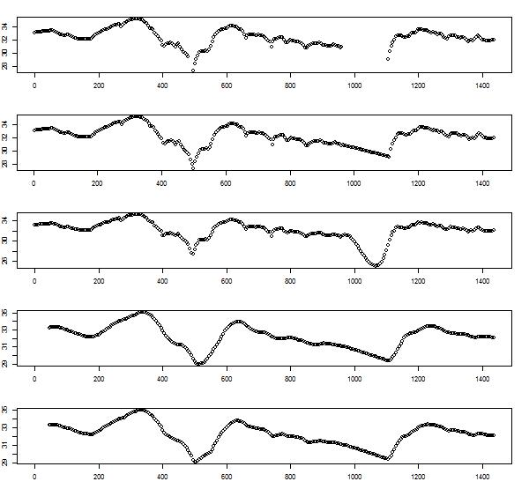
Missing Data Example
Time series of glucose measurements over 24hours.
raw data of glucose level
Time (minutes)
Can we ignore missing values?
Should we fill it in with a constant (eg last value)? Or with a mean? Or a model?
Notes:
- (assuming the tasks in classification—not effective when the percentage of missing values per attribute varies considerably.

Slide 43
Missing Data Example
Time series of glucose measurements
raw data
linear interpolation
(too linear)
polynomial interpolation
(too nonlinear)
Time (minutes)
Notes:
- (assuming the tasks in classification—not effective when the percentage of missing values per attribute varies considerably.

Slide 44
Missing Data Example
Time series of glucose measurements
polynomial
interpolation
(too nonlinear)
polynomial interpolation then smoothed by averaging over windows
(better, but trade offs?)
Time (minutes)
Notes:
- (assuming the tasks in classification—not effective when the percentage of missing values per attribute varies considerably.

Slide 45
Variable Transformations
Why transform data?
Combine attributes
ratios can be more useful
Normalizing data
to same scale
Simplifying data
discrete data is often more intuitive for user and algorithm and helps the algorithms

Slide 46
Feature Engineering is Variable Enhancement
Use Domain and world knowledge to help model
Example: variables exist that represent date and location of doctor visits
deduce a new variable for Number-of-1st-time-visits
deduce a new variable for Number-of-visits-over-25-miles
deduce a new variable for Amount-of-time-between-visits

Slide 47
Adding Information As Variable Enhancement
Example: zip codes
Change ZIP to latitude and longitude
Change ZIP to miles to a reference point
Change ZIP to known category (H,M,L income)
Change ZIP to set of indicator variables (1 per ZIP)

Slide 48
Discretization/Binning May Enhance Data
Discretization
A continuous attribute divided into intervals and replaced by Interval labels
E.g. replace age by functional concepts (such as young, middle-aged, or senior) which may have better predictive value

Slide 49
Simple Discretization Methods: Binning
Equal-width (distance) partitioning:
It divides the range into N intervals of equal size: uniform grid
if A and B are the lowest and highest values of the attribute, the width of intervals will be: W = (B-A)/N.
The most straightforward
But outliers may dominate presentation
Skewed data is not handled well
Equal-depth (frequency) partitioning:
It divides the range into N intervals, each containing approximately same number of samples
Good data scaling
Managing categorical attributes can be tricky

Slide 50
Discretization/Binning Options
E.g. Equal-width (distance) partitioning:
N intervals of equal size, but outliers skew range
E.g. Equal-depth (frequency) partitioning:
N intervals, of equal sample frequency, can help scale data
Is 85 special?
Fall 2003

Slide 51
Variable Transformation Summary
Smoothing: remove noise from data
Aggregation: summarization, data cube construction
Introduce/re-label/categorize variable values
Normalization: scaled to fall within a small, specified range
Attribute/feature construction

Slide 52
Outline
Motivation and Goals
What is data?
Data Preparation:
Organizing data (structural issues)
Preprocessing (data value issues)
Exploring Variables and Descriptive Statistics
Exploring Data Matrix
Outliers, Anomalies, and Visualizations
Notes:
Data prep is now its own topic, even books focused on it, defined by its practice , b/c data is so open ended
The process is iterative, so that one might

Slide 53
Stats for Data Preprocessing
Distributions and histograms
Continuous variables (functions and graphs)
Discrete variables (sets and counting)
Normalizations
Correlations

Slide 54
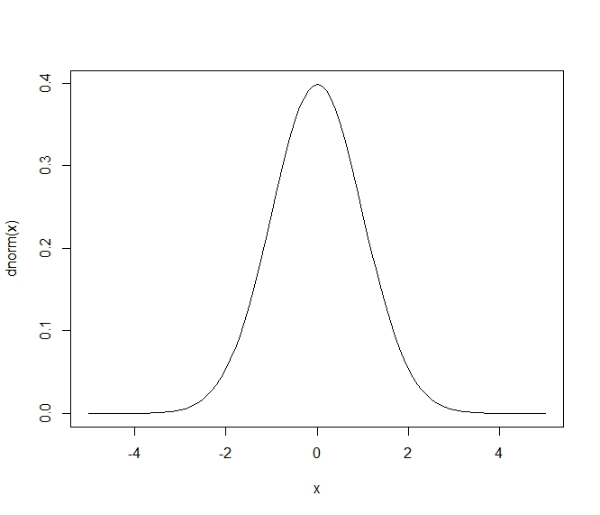
Normal probability density function (PDF)
probability that x=0
Standard Normal
Mean=0
Std deviation=1
probability that x=2

Slide 55
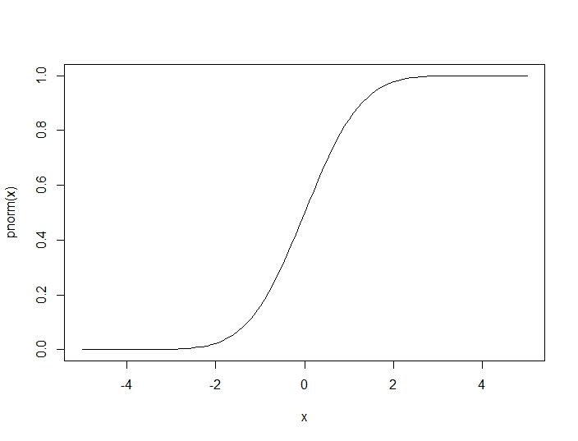
Normal cumulative distribution
Total probability that x<2= .95
(i.e. 95 percent
Total probability that x<0 = .50
(i.e. 50 percent

Slide 56
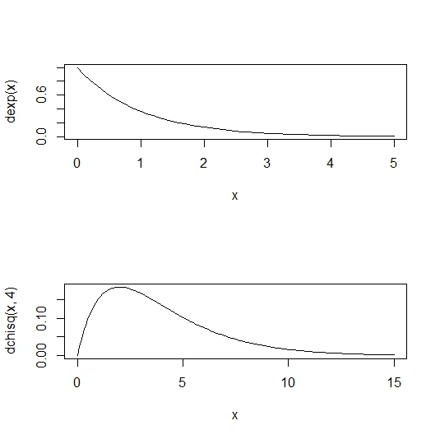
Exponential and Chi-squared density functions
Exponential is good for ‘counts’, ‘events’, etc…,
ie, items that are >0, usually near 0, and higher values more rare
Chi Square is good for ‘costs’, ‘rates’, ‘salaries’, etc…,
ie, items that are > 0, usually not near 0, and higher values more rare

Slide 57
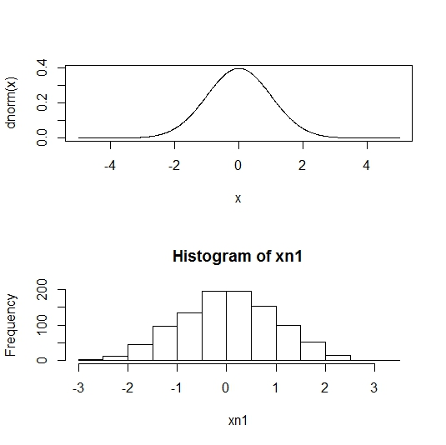
Histogram is a sample PDF
Frequency count ~
probability times sample size

Slide 58
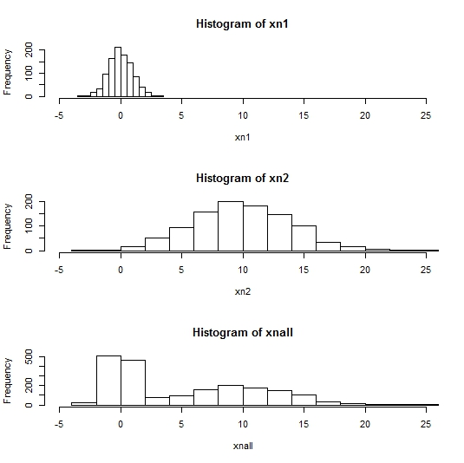
One histogram as mixture
Xn1 has a normal distribution
Xn2 has a normal distribution with
higher mean and higher variance
Xn1 + Xn2 has a
bi-modal distribution

Slide 59
Descriptive Statistics
Mean and Std Dev summarize variables
Transformations and Functions also summarize
E.g. take the highest amount charged for customers in a zip code, take that for each zip code and get a new distribution
E.g. take the difference of 75th to 25th percentile of all customers in a zip code, take that for each zip code and get a new distribution

Slide 60
Data Transformation: Normalizations (to help with scaling)
Mean center
z-score
Scale to [0…1]
log scaling

Slide 61
More Descriptive Statistics
Covariance between 2 variables
Correlation between 2 variables
Ranges -1 to 1
Represents linear relationship

Slide 62
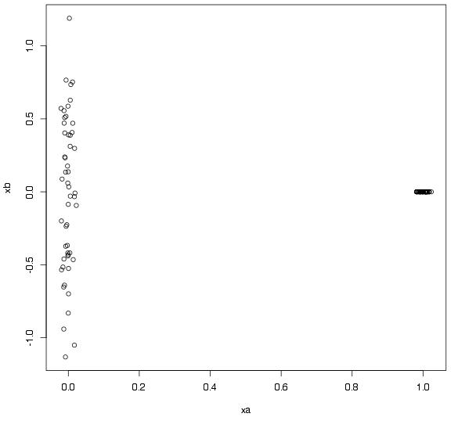
Correlation vs. Independence
No Correlation => Independence
If X near 0, Y is random
If X near 1, Y=0
Correlation = .021
But Y depends on X

Slide 63
More Descriptive Statistics
(Spearman) Rank correlation between 2 variables
Rank the instances of each variable
(now there are 2 ordinal rank variables)
Take correlation coefficient of ranks
Represents monotonic relationship
Confidence interval wrt mean or percentiles

Slide 64
Outline
Motivation and Goals
What is data?
Data Preparation:
Organizing data (structural issues)
Preprocessing (data value issues)
Exploring Variables and Descriptive Statistics
Exploring Data Matrix
Outliers, Anomalies, and Visualizations
Notes:
Data prep is now its own topic, even books focused on it, defined by its practice , b/c data is so open ended
The process is iterative, so that one might

Slide 65
Exploratory Stats for More Variables
Descriptive Statistics Guidelines
Get means and variances, do histograms…
Feature engineering with summary statistics and functions
But for many variables need other steps/tools
More stats
Large P variable selection
Large P dimension reduction
Sampling

Slide 66
Many Variables
More variables => more information, but also more noise and more ways of interactions
2 ways to handle many variables
Variable Selection
Dimension reduction methods

Slide 67
Variable selection vs Dimensionality Reduction
Prior to algorithm, depends on data
For large P, with noise particular to variables, try variable selection
For large P, diffuse noise, try dimension reduction
Notes:
Feature selection:
-Select a minimum set of features such that the probability distribution of different classes given the values for those features is as close as possible to the original distribution given the values of all features
-reduce # of patterns in the patterns, easier to understand

Slide 68
Variable selection
Some algorithms do it already – e.g. random forests will search attribute subsets
Select a minimum possible set of features
reduce # of features in the patterns, easier to understand
Heuristic methods (due to large # of choices):
remove variables with low correlations to outcome
try adding/deleting 1 variable at a time and test algorithm(s)
Notes:
Feature selection:
-Select a minimum set of features such that the probability distribution of different classes given the values for those features is as close as possible to the original distribution given the values of all features
-reduce # of patterns in the patterns, easier to understand

Slide 69
Dimensionality Reduction via Principle Components
Idea: Given N points and P features (aka dimensions), can we represent data with fewer features:
Yes, if features are constant
Yes, if features are redundant
Yes, if features only contribute noise (conversely, want features that contribute to variations of the data)

Slide 70
Dimensionality Reduction via Principle Components
PCA:
Find set of k vectors (aka factors) that describe data in alternative way
First component is the vector that maximizes the variance of data projected onto that vector
K-th component is orthogonal to all k-1 previous components

Slide 71
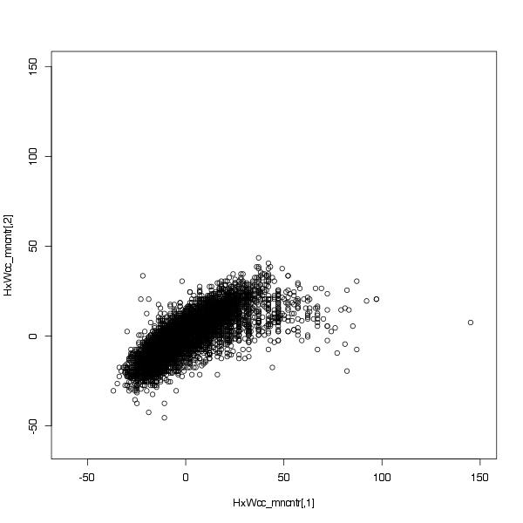
PCA on 2012 Olympic Althetes Height by Weight scatter plot
H
Idea:
Can you rotate the axis so that the data lines up on one axis as much as possible?
Start with one new axis
(e.g. find the one direction that aligns with data)
Height- cm (mean centered)
W
Weight- Kg (mean centered)

Slide 72
PCA on 2012 Olympic Althetes Height by Weight scatter plot
H
E.g. A new axis:
the line H=.8*W
See how points line up on that line and call that the 1st coordinate – aka project onto line H-.8W=0
Algebraically, the new values will be functions of old H and W axis
Height- cm (mean centered)
W
Weight- Kg (mean centered)

Slide 73
PCA on 2012 Olympic Althetes’ Height by Weight scatter plot
If you stop with 1 axis the 2D points are now 1D.
Or, take next axis orthogonal to 1st, continue
Height- cm (mean centered)
Weight- Kg (mean centered)

Slide 74
PCA on 2012 Olympic Althetes’ Height by Weight scatter plot
For 2D data, two new axis can now fully reproduce all points in new space
-.8*Height, 1*Weight
1*Height, .8*Weight

Slide 75
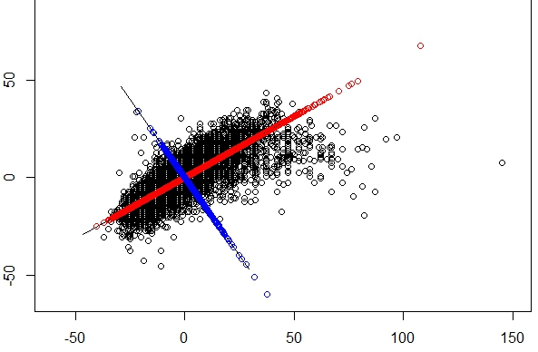
PCA on Height by Weight scatter plot
Total Variance
Conserved:
Var in Weight +
Var in Height
=
Var in PC1 +
Var in PC2
In general:
Var in PC1>
Var in PC2>
Var in PC3…
PC1
PC2
Height- cm (mean centered)
Projection of
(145,0) to
PCs
Weight- Kg (mean centered)

Slide 76
Principle Components
Can choose k heuristically as approximation improves, or choose k so that 95% of data variance accounted
aka Singular Value Decomposition
PCA on square matrices only
SVD gives same vectors on square matrices
Works for numeric data only
For higher dimensional data, use PCA to visualize 2 factors at a time

Slide 77
Outline
Motivation and Goals
What is data?
Data Preparation:
Organizing data (structural issues)
Preprocessing (data value issues)
Exploring Variables and Descriptive Statistics
Exploring Data Matrix
Outliers, Anomalies, and Visualizations
Notes:
Data prep is now its own topic, even books focused on it, defined by its practice , b/c data is so open ended
The process is iterative, so that one might

Slide 78
Anomalies
3 working definitions of an anomaly
statistical outlier (far from mean)
distance based (farthest point to its neighbors)
deviance based (model quantity, take biggest error to model)
Making decisions and cutoffs
anomalies can be ranked
but decisions depend on some cutoff

Slide 79
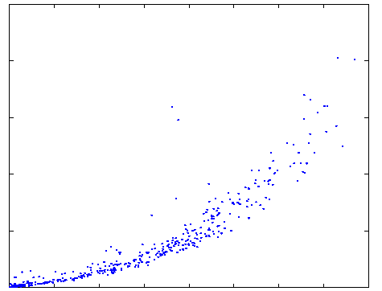
The importance of normalization and varieties of deviance
Not an outlier in
# Rx or in total Rx
Outliers for #Rx/total Rx
Far from others
Deviant wrt main trend
20K
Total RX transactions
(#197,408)
each dot is
1 Pharmacy
1
1
# of different Rx prescribed
1600

Slide 80
Visualizations
For communication and exploration
MultiDimensional Scaling (MDS)
Find points in 2D that preserve relative distances in P-dimensions of full data matrix
In some cases similar to PC1 and PC2
Plotting relations between variables
Heat Maps over vectors
Discretize into bins and labeled by a few colors

Slide 81
Summary
Data preparation is a key issue for mining
Lots of techniques
Partly an art that depends on data and algorithm knowledge
Partly a science that depends on statistical principles

Slide 82
Reading Material
Data Preparation for Data Mining by Dorian Pyle
http://www.ebook3000.com/Data-Preparation-for-Data-Mining_88909.html
Data mining – Practical Machine learning tools and techniques by Witten & Frank
http://books.google.com

